Slide 1
Linked List

Slide 2
Topics
Singly Linked List (단일 연결 리스트)
Doubly Linked List (이중 연결 리스트)

Slide 3
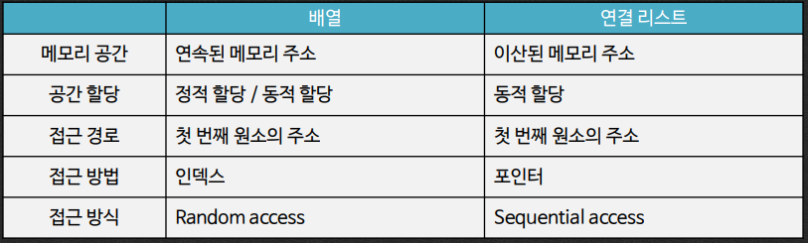
Array vs. Linked List
Unknown length of a sequence of data → Linked List
e.g., 회원관리

Slide 4
Singly Linked List
A singly linked list is a concrete data structure consisting of a sequence of nodes
Each node stores
element
link to the next node
next
elem
node
∅
A
B
C
D

Slide 5
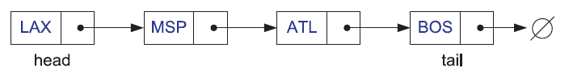
Singly Linked List – head, tail
Head: the first node
Tail: the last node
assign null for the next node link
next
elem
node

Slide 6
Singly Linked List – example
Node class (string data example)
class StringNode {// a node in a list of strings
private:
string elem;// element value
StringNode* next;// next item in the list
friend class StringLinkedList;
// provide StringLinkedList access
};
next
elem
node

Slide 7
Singly Linked List – example (cont.)
Singly linked list class
class StringLinkedList {// a linked list of strings
public:
StringLinkedList();// empty list constructor
~StringLinkedList();// destructor
bool empty() const;// is list empty?
const string& front() const;// get front element
void addFront(const string& e);// add to front of list
void removeFront();// remove front item list
private:
StringNode* head;// pointer to the head of list
};

Slide 8
Singly Linked List – example (cont.)
Member methods
StringLinkedList::StringLinkedList()// constructor
: head(NULL) { }
StringLinkedList::~StringLinkedList()// destructor
{ while (!empty()) removeFront(); }
bool StringLinkedList::empty() const// is list empty?
{ return head == NULL; }
const string& StringLinkedList::front() const// get front element
{ return head->elem; }

Slide 9
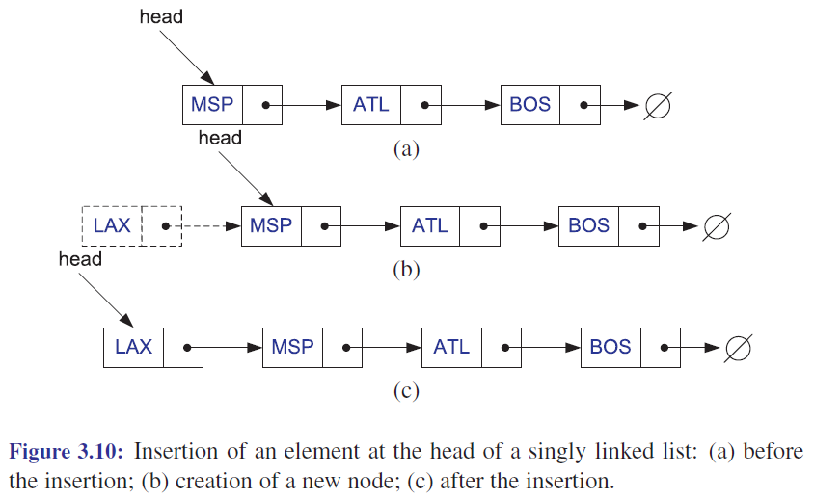
Singly Linked List – example (cont.)
Insertion to the front

Slide 10
Singly Linked List – example (cont.)
Insertion to the front
void StringLinkedList::addFront(const string& e) {// add to front of list
StringNode* v = new StringNode; // create new node
v->elem = e; // store data
v->next = head; // head now follows v
head = v; // v is now the head
}

Slide 11
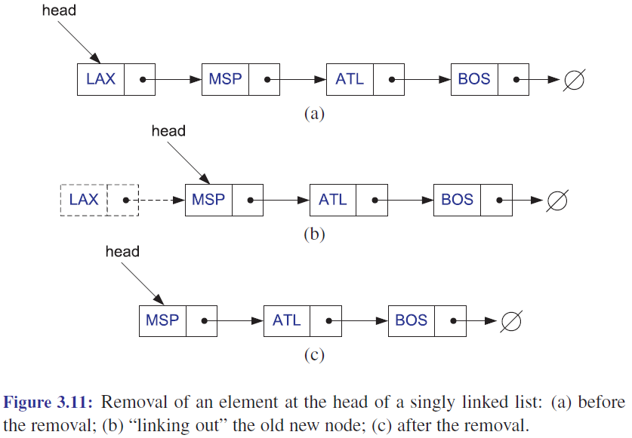
Singly Linked List – example (cont.)
Removal from the front

Slide 12
Singly Linked List – example (cont.)
Removal from the front
void StringLinkedList::removeFront() {// remove front item
StringNode* old = head; // save current head
head = old->next; // skip over old head
delete old; // delete the old head
}

Slide 13
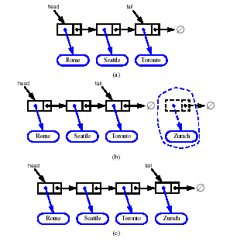
Inserting at the Tail
Allocate a new node
Insert new element
Have new node point to null
Have old last node point to new node
Update tail to point to new node

Slide 14
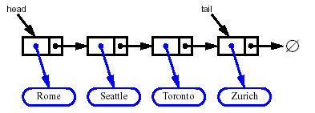
Removing at the Tail
Removing at the tail of a singly linked list is not efficient!
There is no constant-time way to update the tail to point to the previous node

Slide 15
Next
Doubly Linked List

